Slide 1


Dynamic Pricing For Online Portal
Aldel Education Trust’s
St. John College of Engineering and Management, Palghar
NAAC Accredited with Grade A+
Department of Information Technology
Nikhil Sharma [EU1224039]
Ved Singh[EU1224052] Om Shingare[EU1224007] Piyush Jangale[EU1224048]
Guide Name Mrs. Pratiksha patil
Oct 24, 2024
1

Slide 2
Contents
Introduction
Motivation
Problem Statement
Objectives
Scope
Review of Existing Literature
Proposed System
Block diagram of Proposed System
Implementation
Algorithm/Flowchart
Screenshots of the output with description
Results and Discussion
Conclusion and Future Work
References
2

Slide 3
Abstract
This project aims to develop a dynamic pricing model for ride-sharing services by leveraging historical data to analyze the relationship between the number of drivers, riders, and pricing fluctuations. The model will allow users to manually input the number of available drivers and riders, and subsequently display the corresponding fare based on historical trends and demand patterns. By utilizing advanced data analytics techniques, including regression analysis and machine learning, the project will identify key factors influencing pricing, such as peak times, geographic demand, and driver availability. The dynamic pricing system not only provides real-time pricing insights but also enhances decision-making for both service providers and customers, ultimately aiming to optimize the balance between supply and demand. Additionally, it will facilitate better forecasting and resource allocation for ride-sharing companies, improving operational efficiency and customer satisfaction. The findings will contribute to a deeper understanding of pricing strategies in the ride-sharing industry, potentially informing future operational and marketing decisions while addressing issues like price fairness and transparency.
3

Slide 4
Introduction
Motivation:
This project is motivated by the increasing complexity of the ride-sharing industry and the need for efficient pricing strategies. As demand for ride-hailing services grows, traditional fixed pricing models often result in inefficiencies and customer dissatisfaction. By developing a dynamic pricing model that leverages historical data, this project aims to create a responsive pricing strategy that aligns with real-time market conditions. This approach will empower ride-sharing companies to optimize fares, enhance transparency for customers, and improve overall operational efficiency. Ultimately, the goal is to foster a more sustainable and equitable ride-sharing ecosystem for drivers, riders, and service providers.
4

Slide 5
Introduction
Problem Statement :
The ride-sharing industry faces significant challenges related to pricing inefficiencies, particularly during fluctuations in demand and supply. Traditional pricing models often fail to adapt to real-time market conditions, leading to customer dissatisfaction and suboptimal resource allocation. This results in instances of unfair surge pricing and a lack of transparency for riders. Additionally, drivers may experience inconsistent earnings due to unpredictable fare structures. Therefore, there is a pressing need for a dynamic pricing model that leverages historical data to better align fares with actual demand and supply, ultimately enhancing the experience for both riders and drivers while improving operational efficiency for service providers.
5

Slide 6
Introduction
Objectives:
The primary objective of this project is to develop a dynamic pricing model for ride-sharing services that utilizes historical data to optimize fare calculations based on real-time demand and supply conditions. Specifically, the project aims to identify key factors influencing pricing, such as peak times and geographic demand, to provide accurate fare estimates. Additionally, the model will empower service providers to make data-driven decisions, enhancing operational efficiency and resource allocation. Ultimately, the objective is to create a fairer, more transparent pricing structure that improves customer satisfaction for riders and earnings consistency for drivers in the ride-sharing ecosystem.
6

Slide 7
Introduction
Scope:
This project focuses on developing a dynamic pricing model for ride-sharing services through several key components. First, it involves collecting and analyzing historical ride data, including demand patterns and fare fluctuations. Second, the project will create a user-friendly interface for users to input the number of drivers and riders, generating real-time fare estimates. Additionally, rigorous testing will ensure the model’s accuracy and reliability. The project will provide implementation guidelines for integrating the model into existing platforms. Finally, it will evaluate the model's impact on fare fairness, driver earnings, and customer satisfaction, while suggesting areas for future improvements.
7

Slide 8
Literature Review
Sr. No | Paper Title | Author | Methodology | Research Gap
1. | A Machine Learning Framework for Predicting Purchase by Online Customers based on Dynamic Pricing | Rajan Gupta, Chaitanya Pathak . | The paper proposes a framework combining various techniques, including machine learning, data mining, and statistical methods, to predict customer purchase behavior based on dynamic pricing. | The paper mentions that while there are various existing models for dynamic pricing (such as agent-based models, inventory-based models, and game theory models), none effectively combine multiple techniques to address purchase behavior prediction through dynamic pricing.
2. | An Application of Reinforced Learning-Based Dynamic Pricing for Improvement of Ridesharing Platform Service in Seoul | Jaein Song,Yun Ji Cho,Min Hee Kang,Kee Yeon Hwang | The study employed reinforcement learning (RL) to determine optimal surge pricing for ridesharing services. | The study identifies a lack of research in addressing the regional equity problem in ridesharing services, particularly in marginalized or low-demand areas during late-night hours.
3. | Demand Prediction for Ride-Sharing Services | Chen, Y., et al. | The paper reviews various dynamic pricing algorithms, analyzing their effectiveness in optimizing revenue through real-time fare adjustments based on demand and supply. It includes case studies of implemented models in existing ride-sharing platforms. | Limited exploration of user acceptance and transparency issues related to dynamic pricing .
4
5

Slide 9
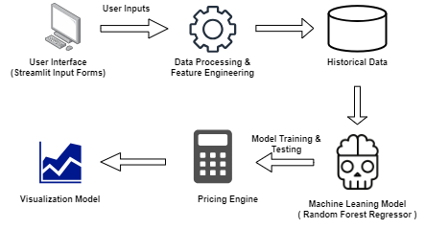
Proposed System
Fig. 1: Block Diagram
10

Slide 10
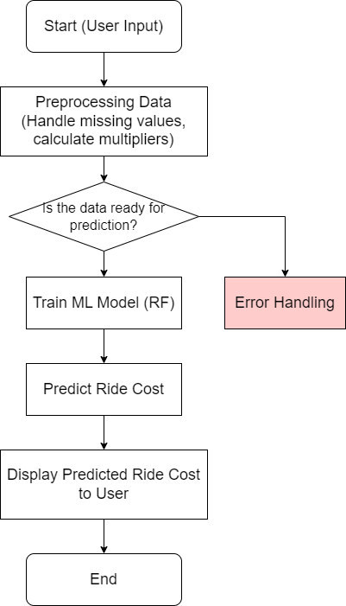
Proposed System
Fig. 2: Flowchart
11

Slide 11
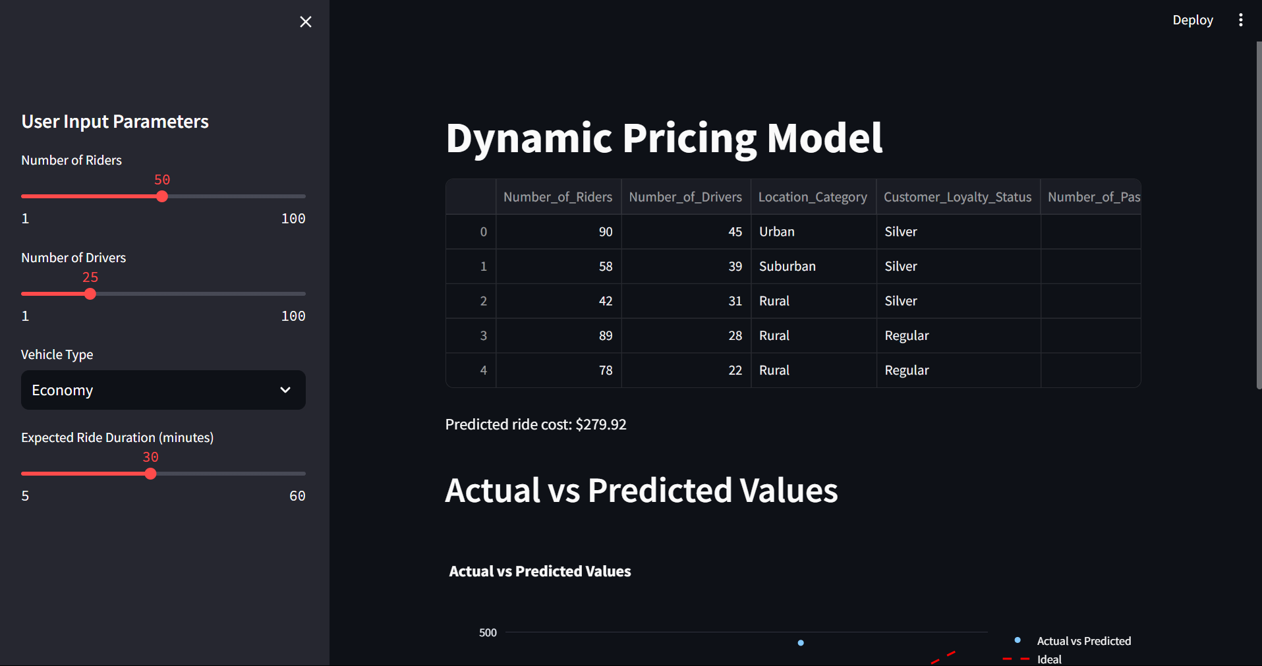
Implementation

Slide 12
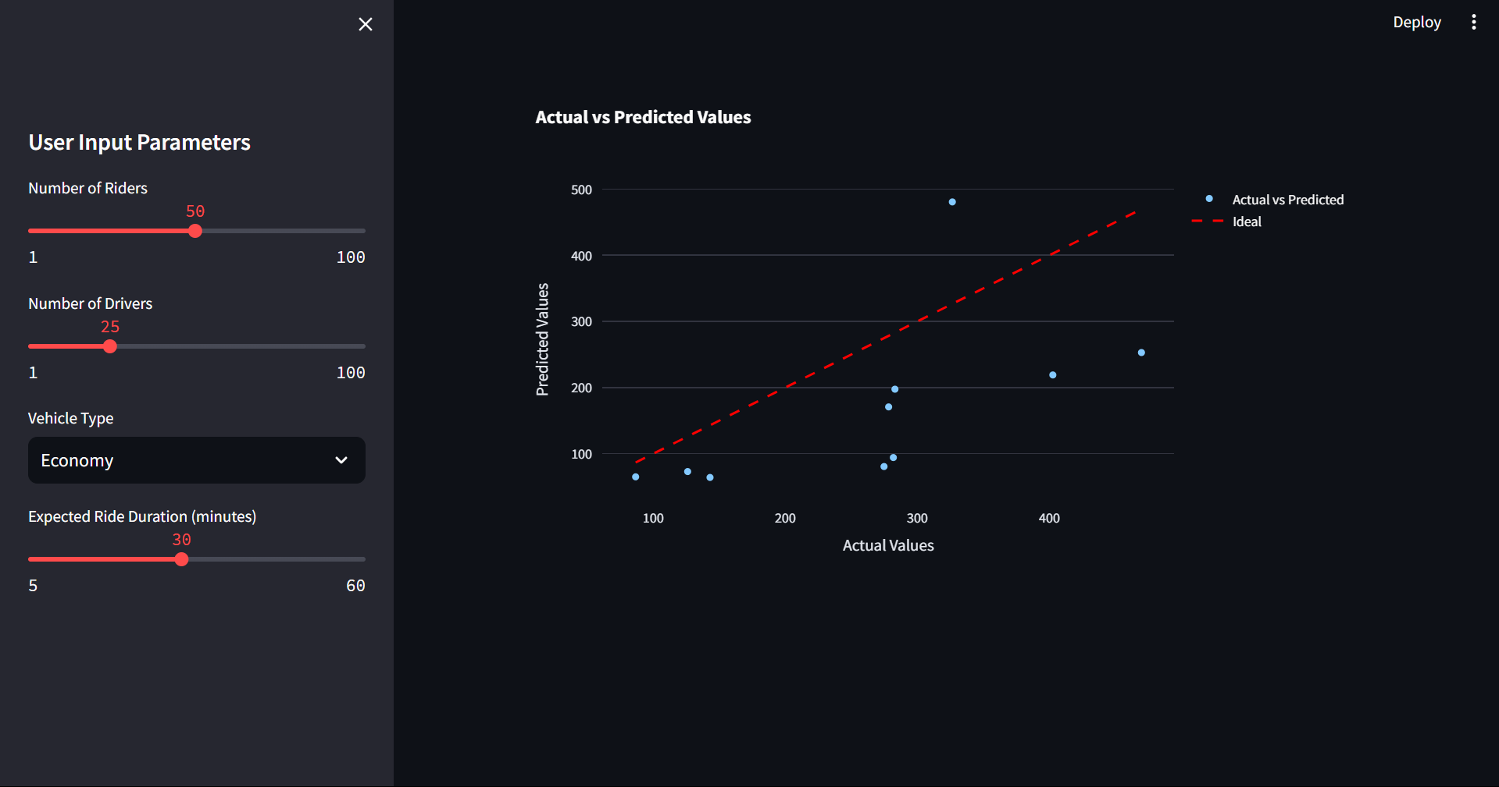
Implementation

Slide 13
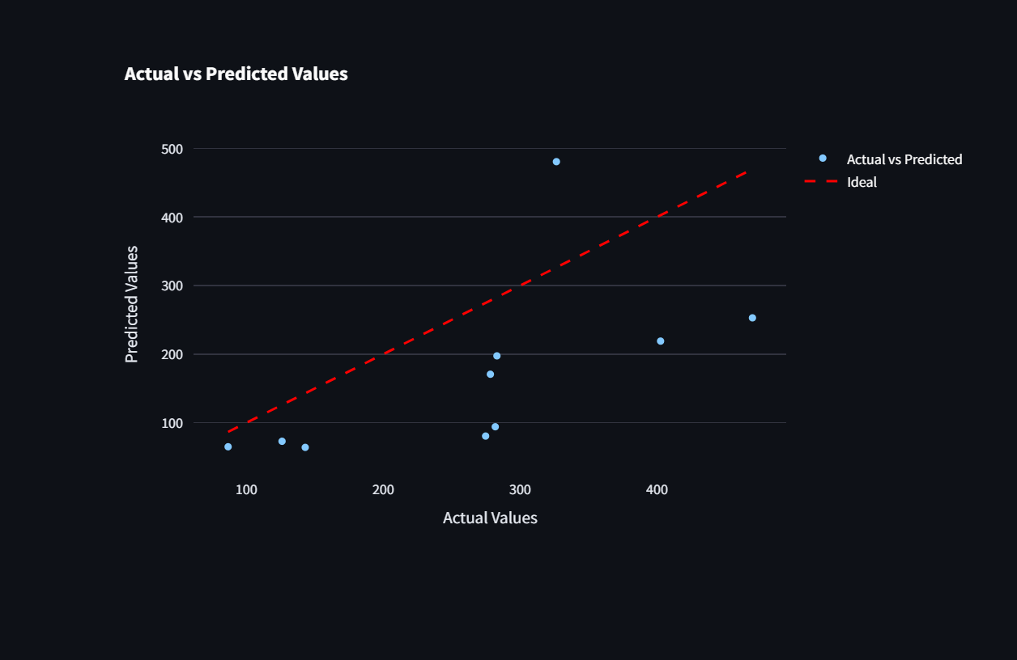
Implementation
12

Slide 14
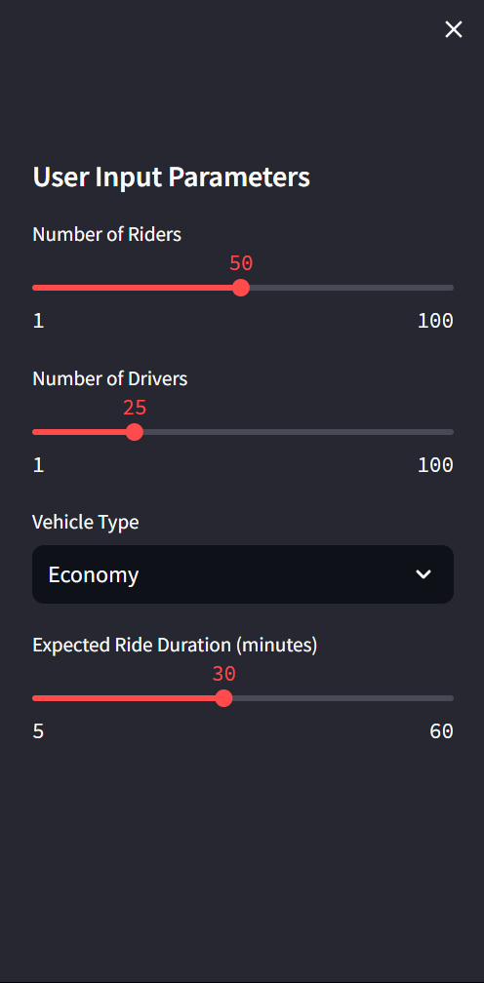
Implementation
13

Slide 15
Conclusion and Future Work
Conclusion:
This project aims to develop a dynamic pricing model for ride-sharing services that effectively leverages historical data to optimize fare calculations based on real-time demand and supply. By integrating advanced data analytics and user-friendly interfaces, the model seeks to enhance transparency and fairness in pricing, ultimately improving customer satisfaction and driver earnings. The findings will contribute valuable insights into pricing strategies, promoting a more efficient and equitable ride-sharing ecosystem that adapts to market fluctuations and user needs.
16

Slide 16
Conclusion and Future Work
Future Work:
1.Integration of External Factors: Incorporate variables such as weather conditions, local events, and traffic patterns to enhance demand forecasting accuracy.
2.User Feedback Mechanism: Develop a system to collect real-time feedback from users regarding pricing perceptions and satisfaction, allowing for continuous model refinement.
3.Geographical Expansion: Test and adapt the pricing model across diverse Indian cities and rural areas to assess its applicability in varying contexts.
4.Longitudinal Studies: Conduct long-term studies to evaluate the effects of dynamic pricing on driver retention and customer loyalty over time.
17

Slide 17
Conclusion and Future Work
5.Fairness Metrics Enhancement: Explore additional fairness metrics and implement them into the pricing model to ensure equitable outcomes for all stakeholders.
6.Machine Learning Improvements: Investigate advanced machine learning techniques, such as deep learning, to further refine demand prediction and pricing strategies.

Slide 18
References
[1] Nath A, Khandelwal A, Kanojia A, Minocha I, Niyogi R (2017) Design and implementation of an intelligent cab service system. In: 2017 tenth international conference on contemporary computing (IC3). IEEE, pp 1–6
[2]Salanova, J.M., Estrada, M., Aifadopoulou, G., Mitsakis, E.: A review of the modeling of taxi services. Procedia Soc. Behav. Sci. 20, 150–161 (2011)
[3]An Application of Reinforced Learning-Based Dynamic Pricing for Improvement of Ridesharing Platform Service https://www.mdpi.com/2079-9292/9/11/1818
[4] A Study on Dynamic Pricing Models Using Machine Learning Algorithmshttps://www.mit.edu/~dbertsim/papers/Revenue%20Management/Dynamic%20Pricing-%20A%20Learning%20Approach
[5] LingAdeu Optimizing Ride Fares: A Dynamic Pricing Model for Ride-Sharing Services https://github.com/LingAdeu/dynamic-pricing-model
18

Slide 19
Thank You !!!
19

Slide 20
Q & A
20

